Slide 1
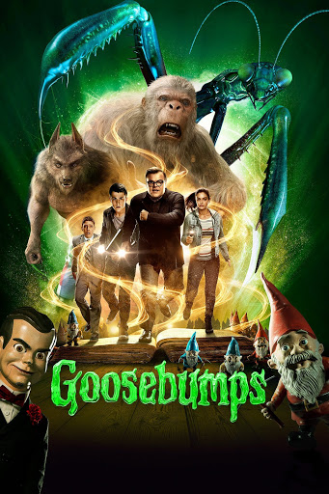
Autumn Term’s
Reading Challenge
This term’s challenge is based on the books…

Slide 2
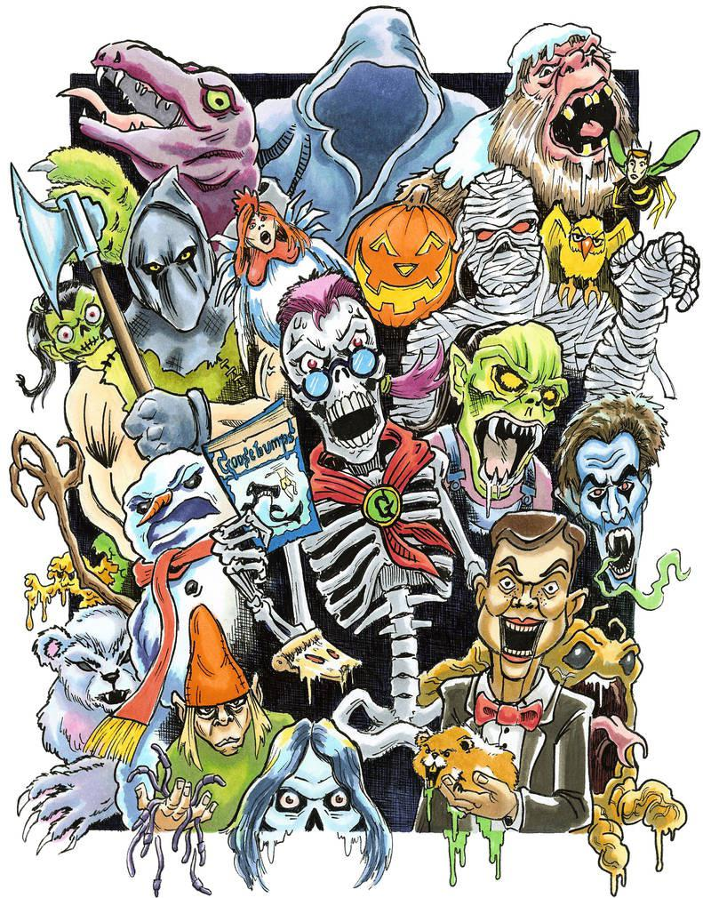
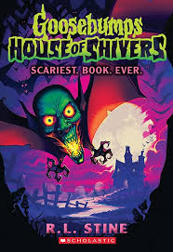
Autumn Term’s
Reading Challenge
What is the story about?
Goosebumps is a series of horror novels written by American author R. L. Stine.
These stories are about children/teenagers who often find themselves in situations where they need to fight off monsters, ghouls, ghosts and mummies etc…

Slide 3
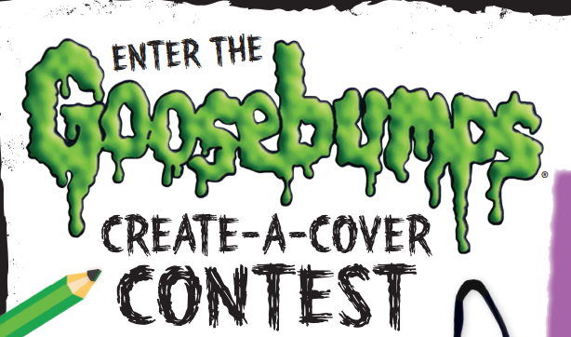
Autumn Term’s
Reading Challenge
You do not need to read all of the books to enter
Create a new front cover for the new Goosebumps book coming out

Slide 4
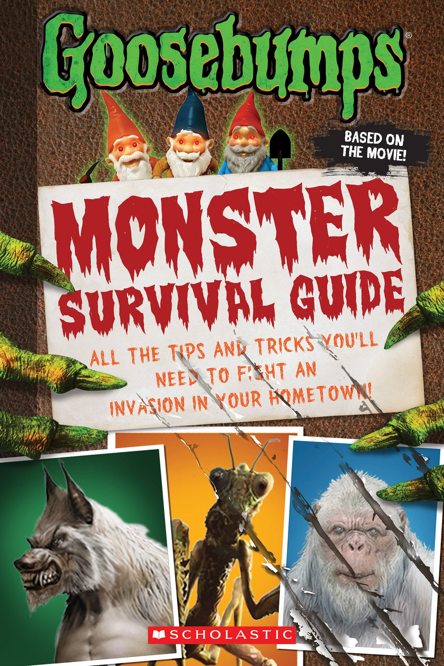
Autumn Term’s
Reading Challenge
You do not need to read all of the books to enter
Create your own monster survival guide. You can also create your own monsters! They do not need to be the ones from the books.
You could use the computer to type if it you don’t want to write it.

Slide 5
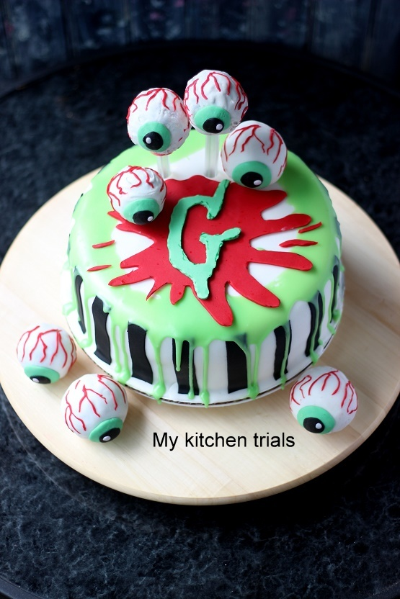
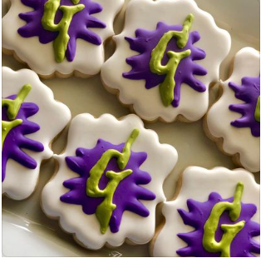
Autumn Term’s
Reading Challenge
You do not need to read all of the books to enter
Goosebumps themed baking. It could be some biscuits, a cake, a meal or any other creative ideas you make have.
Send in a photo!

Slide 6
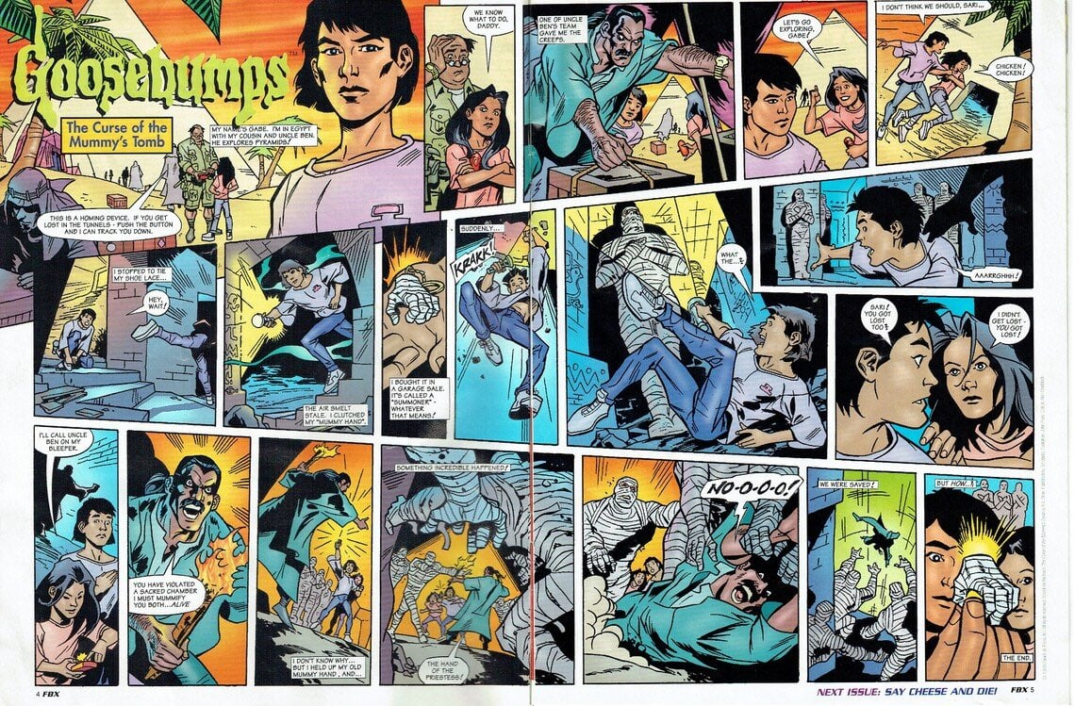
Autumn Term’s
Reading Challenge
You do not need to read all of the books to enter
Create a comic strip showing a recreation of your favourite Goosebumps story, or you can create a brand new story

Slide 7
You could enter in a variety of different ways:
Create a fact file about your favourite monster
Create a scene of monsters taking over Walmley (drawing, painting, collage)
Write a new Goosebumps chapter including your own monsters and characters
Make a model of a monster
Take a photo of yourself dressed up as a monster
These are just ideas so if you can think of a better, more creative way to enter…GO FOR IT!
How could you enter?

Slide 8
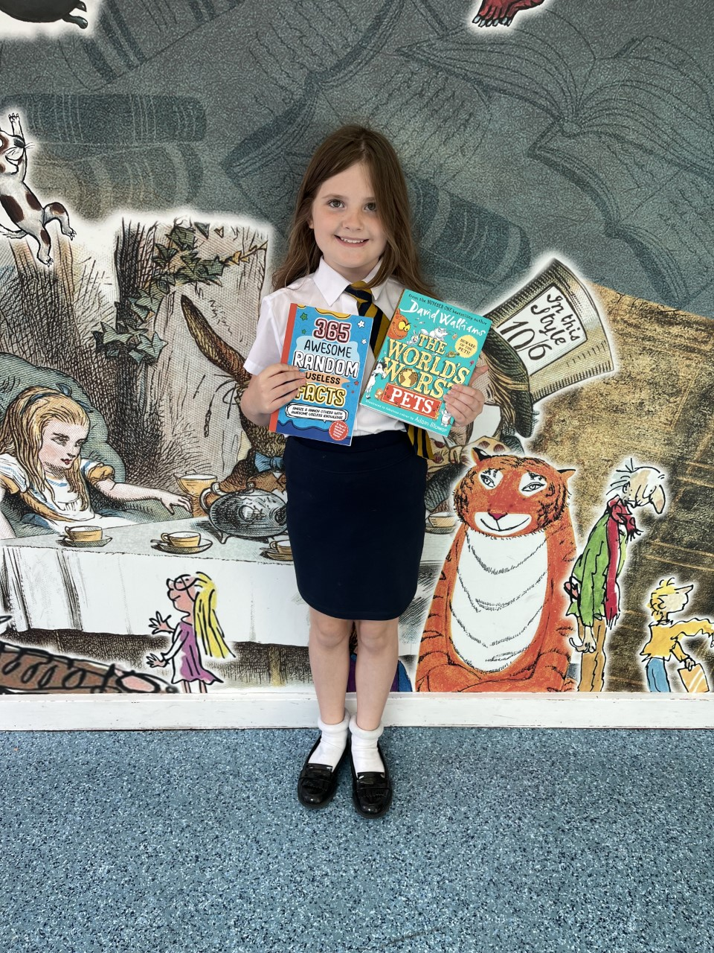
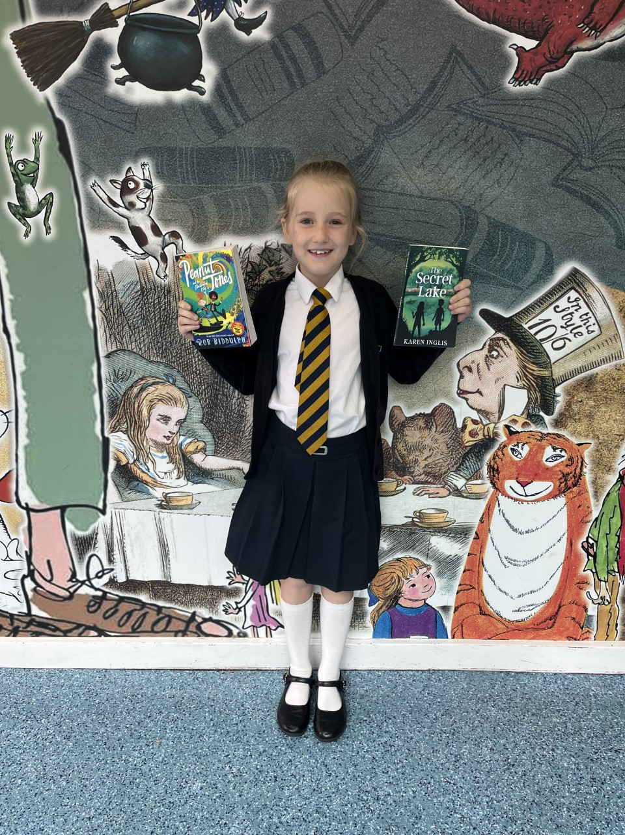
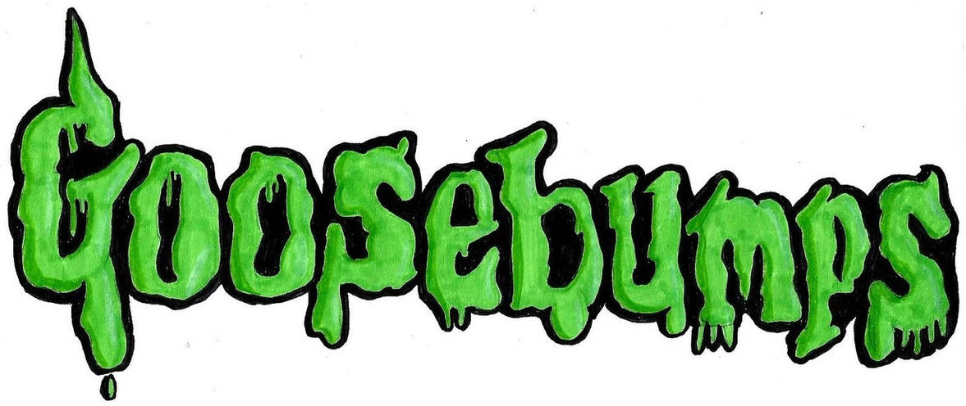
What is the prize?
All entries must be handed to Mr. Ware (Class 8) before Wednesday 13th December 2023. Mr. Pearson, Mrs. Harris and Mrs. Smith will judge to make it fair!
There will be FIVE winners!
Each winner will be able to select 2 books of their choice to be ordered online by Mr. Ware.

