Slide 1
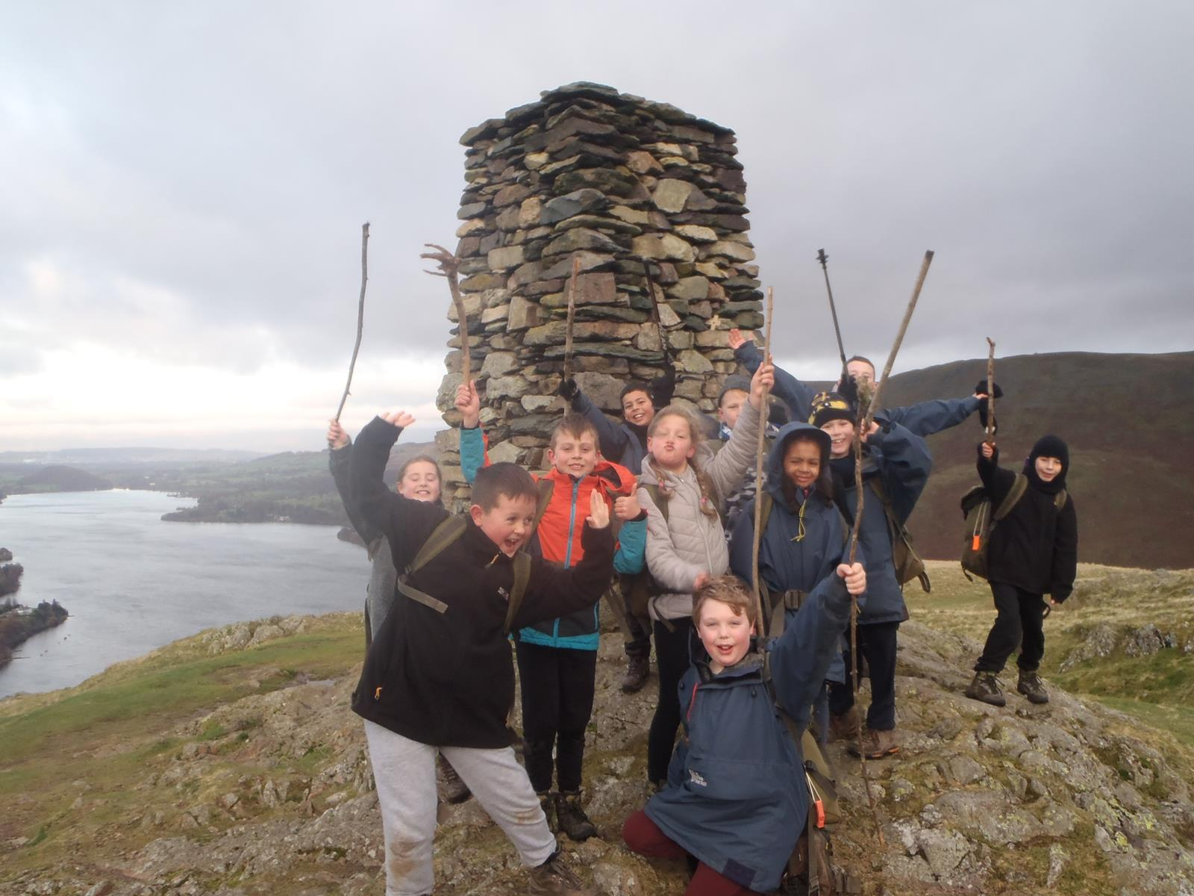

Slide 2
Outward Bound Centre Howtown, Ullswater

Slide 3
The Outward Bound Trust

Slide 4
Purpose of presentation

Slide 5
Aims of the trip

Slide 6
The Centre

Slide 7
A Typical Day…

Slide 8
Activities

Slide 9
Activities

Slide 10
Activities

Slide 11
Activities

Slide 12
Activities

Slide 13
Activities

Slide 14
Activities

Slide 15
Equipment

Slide 16
Groups

Slide 17
Dormitories

Slide 18
Food and drink

Slide 19
Travelling arrangements

Slide 20
Cost!

Slide 21
More details

Slide 22
And Finally...

